Slide 1
Capacity Building and Raising Awareness in Europe and in Third Countries to Cope with Xylella fastidiosa – “CURE-XF”
In collaboration with:
International Summer School
Modelling the spread of Xylella fastidiosa
for improving the surveillance programs
Dr Daniel Chapman, UKRI Centre for Ecology & Hydrology, UK
CIHEAM Bari, 1st October 2018
#CureXFSS2018

Slide 2


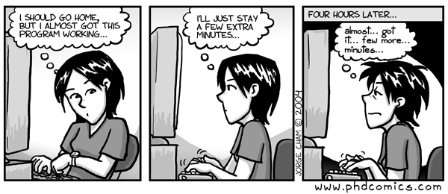
In the session we will use the computer language R to run models...
...but you will not need to know any coding in R!!!

Slide 3
Please bring your laptop to the session on 1st October. Before then, please follow these instructions to install R
Download and install R 3.5.1 from https://cran.stat.unipd.it/ or any of the ‘mirrors’ linked at https://cran.r-project.org/mirrors.html
Install all the R packages (libraries of functions) we need to run the models. To do this open R and paste this directly into the console...
install.packages(c("shiny","ggplot2","reshape","deSolve", "data.table", "readr"), dependencies=TRUE, repos='http://cran.us.r-project.org')

Slide 5

Before we begin...
You will need a laptop and an internet connection
Please download and install R 3.5.1 from https://cran.stat.unipd.it/ or any of these mirrors

Slide 7
title
Text

Slide 8
Conclusions - Calibri, 32 pt
You can add Pictures or Charts if you wish
Text – Calibri, 16 pt
Add description / credit of the picture or chart
You can add Pictures or Charts if you wish
Add description / credit of the picture or chart

Slide 9
Thank You
Get in Touch
Address
put your NAME here
E-mail
Phone number

